Slide 1
A Few Legal Tips
Interesting and (hopefully) Helpful

Slide 2
Business
Separate your business from your home
Financially
Mentally
Incorporate!
Use Contracts!
Notes:
Separating you business from your home life can greatly reduce stress
Financially you should keep separate accounts. Even if your just a single person, you should keep a business account and a personal account. It will help you come tax season and will keep you in track with what expenses belong where.
Mentally, you should practice leaving work at work, and, for that matter home at home. You can save a lot of anxiety and potential conflicts with spouse, children, and co-workers, by practicing trying to keep mental categories.
Legally speaking though, I want you to think about incorporating. This creates a separate entity which will hold your business. The best form for small business owners is through an LLC. LLC’s are not difficult and not expensive to form. The whole process can be done on one printable PDF and costs about $125. I think $30 more if you want a wall certificate.
An equally important and just as often ignored concept is that of contracts. Contracts, you think, well they’re long and complicated and I’m just doing business with Jim down the street.
It doesn’t matter. A contract will provide you peace of mind, and give you a basis for your thinking versus the other parties’ thinking. It will clearly set out things like: payment, obligations, quality expectations, time for fulfillment (if any), time to correct, and what might cause the contract to end.
Business-wise, my legal tips for you are to incorporate and use a contract. No matter how small the issue is.

Slide 3
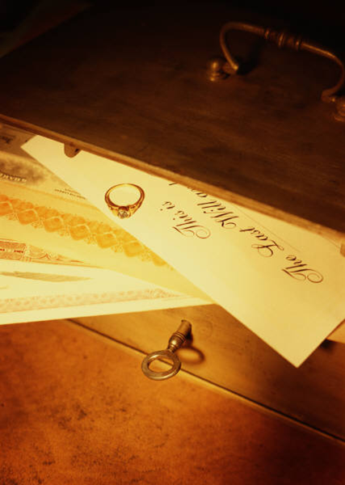
Estate and Health
Write a will
Its not just for rich old people
Pick your beneficiaries carefully
Consider a living will and a who you
would give power of attorney to
Notes:
Plan how your estate should be disposed of in the event of your death. Its ugly, but it happens every day. Your estate plan tells who you want to get your “stuff” and often plans for funeral costs and life insurance policies. Often estate planning consists of nothing more than a will.
Writing a will is very important. Wills are not just for people who have a lot of money, or people who are very old. Wills are for anyone who has something they’d like to make sure goes to the right person at their own death.
If you have a house, a car, a bank account, even a dog, you should consider a will. The law provides some default rules, but those rules may surprise you.
Re-write your will every five years. A handwritten will can suffice, but each new will cancels the old one.
Explain living will and power of attorney.
If you have a bike, a home, a bank account, even a dog, you should write a will.
When writing the will, pick your beneficiaries carefully, and we lawyers recommend rethinking this every five years. Who you love, and who you want to benefit, and who is in or out of your life, changes often. And if you leave something to someone who has already passed, or who by the time you pass you wouldn’t want to have that item anymore, then

Slide 4
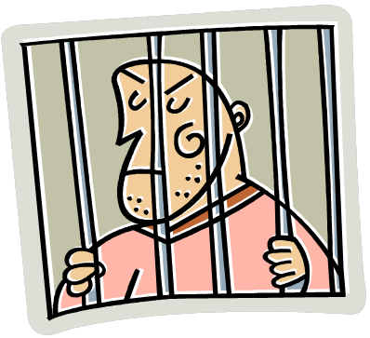
Criminal Defense
Miranda Warnings
Right to remain silent
Right to an attorney
When aren’t they given?
What is allowed at a DUI stop?
Road block
Standard rules, length of stop, no reasonable suspicion needed
Individual stop
Reasonable suspicion, must show were driving and drunk

Slide 5
Criminal Defense
Search
Home-
Warrant or exigent circumstances (lawyer-speak for emergency)
Permission
Vehicle
Almost always permitted but technically need reasonable suspicion
Incident to arrest
After impounding
With permission
Of the Person
Incident to arrest or with permission

Slide 6
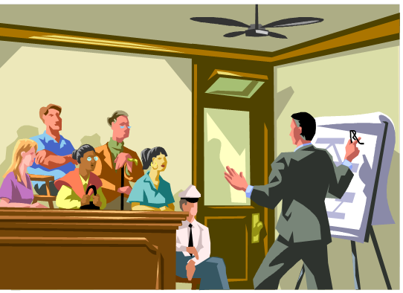
Civil Defense
Not entitled to an attorney
Talk to an experienced attorney before responding
Preliminary Objections
Small Claims Court
Preserving things for appeal
Settlement

Slide 7
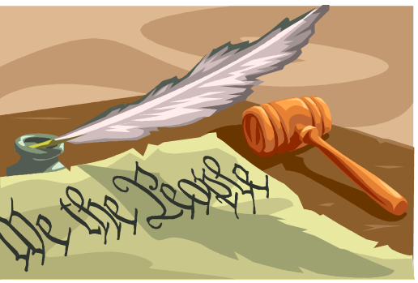
Civil Rights
Intersects with your criminal rights
Lack remedy unless criminal case is brought
Wrongful Death
Bivens Action
Egregious/malicious wrongs
Overcoming immunity
State (11th Amendment)
Municipal
Employers

Slide 8
Questions?
Shannon K. McDonald
27 S. Darlington St.
Second Floor
West Chester, PA 19125
shannonk@mcdonalddefense.com
267-702-0648

